Slide 1

WAY TO ENTERPRISE
Java Basics
VTI ACADEMY
Author: duy.nguyenngoc1@vti.com.vn
March 2020

Slide 2
Agenda
Debug
Handling Exception
Assignments
Copyright © VTI Academy All Rights Reserved

Slide 3
Debug
Breakpoint
Debug mode
Expression
Variable

Slide 4
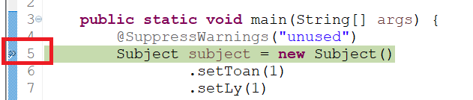
Breakpoint

Slide 5
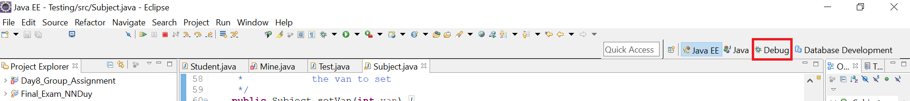
Debug Mode
Step into (F5)
Step return (F7)
Step over (F6)
Resume (F8)
Stop (Ctrl + F2)
Debug Mode (Alt + Shift + D + J)

Slide 6
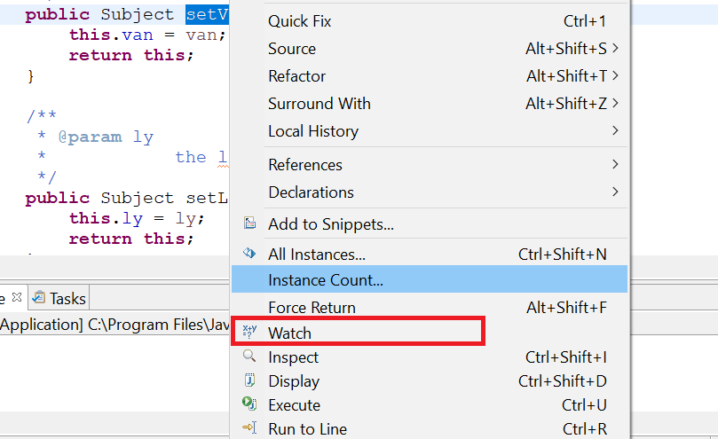
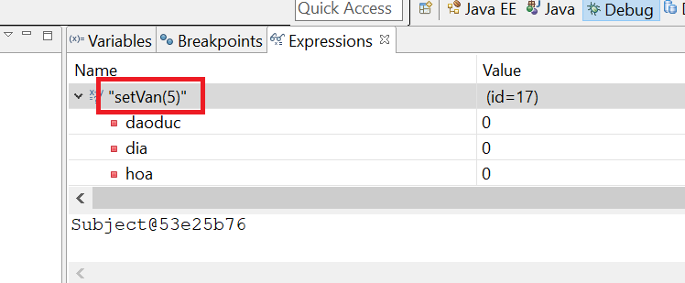
Expression

Slide 7
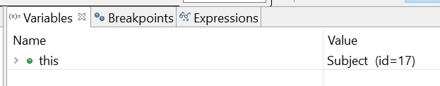
Variable

Slide 8
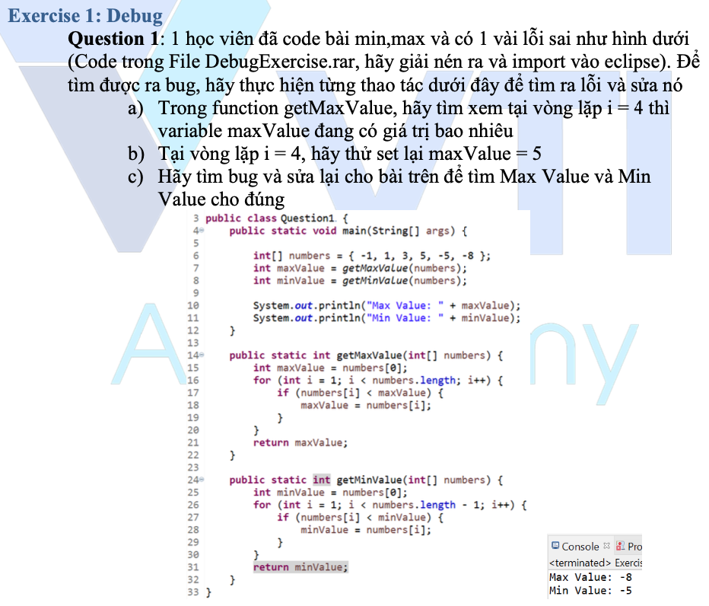
Testing System Assignments
Exercise 1: Debug

Slide 9
Handling Exception
Catch
Compile error
Logical error
Common Exception
ArrayIndexOutOfBoundException
ArithmeticException
NullPointerException

Slide 10
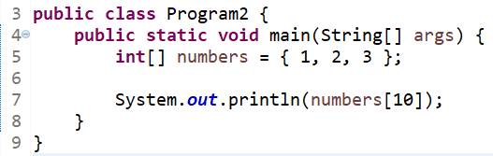
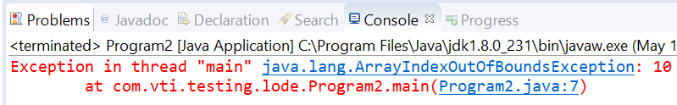
ArrayIndexOutOfBoundException

Slide 11
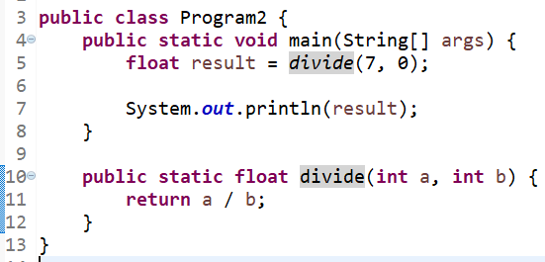
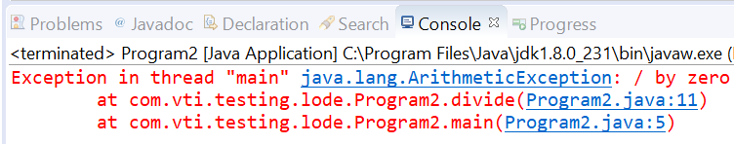
ArithmeticException

Slide 12
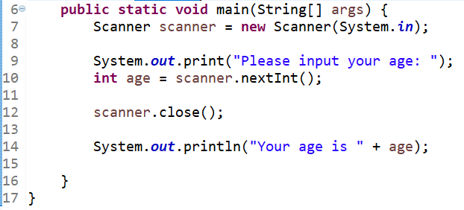
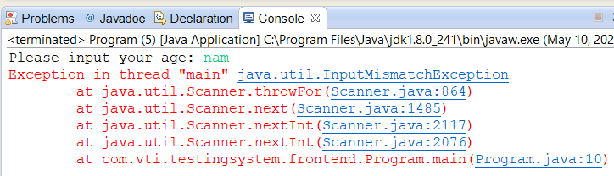
InputMismatchException

Slide 13
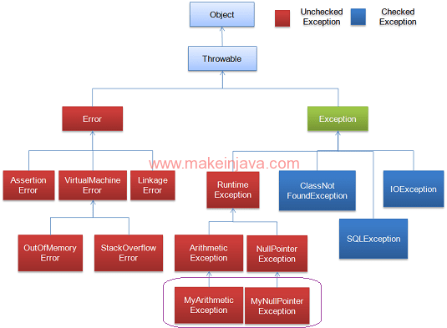
Exception

Slide 14
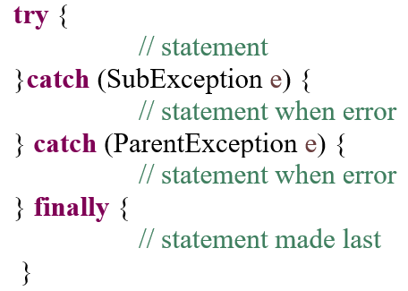
Syntax

Slide 15
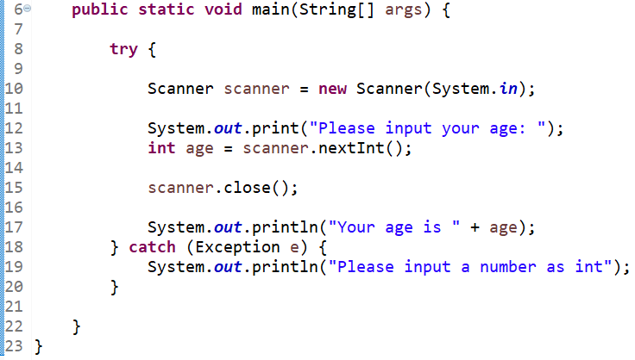
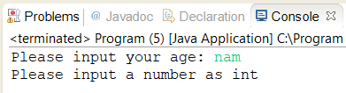
Example 1

Slide 16
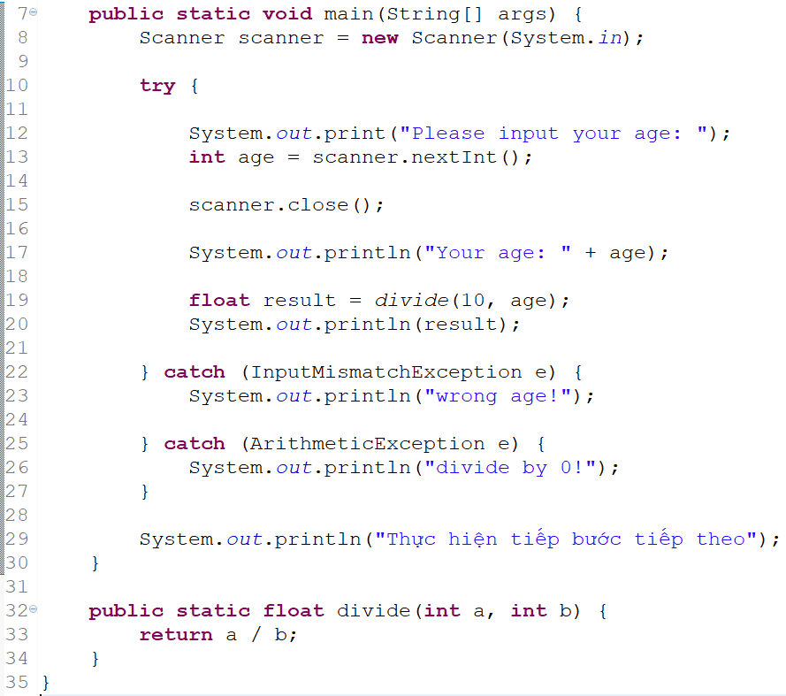
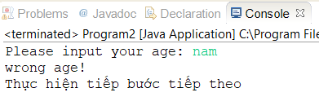
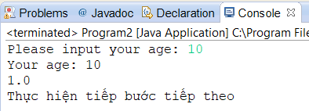
Example 2

Slide 17
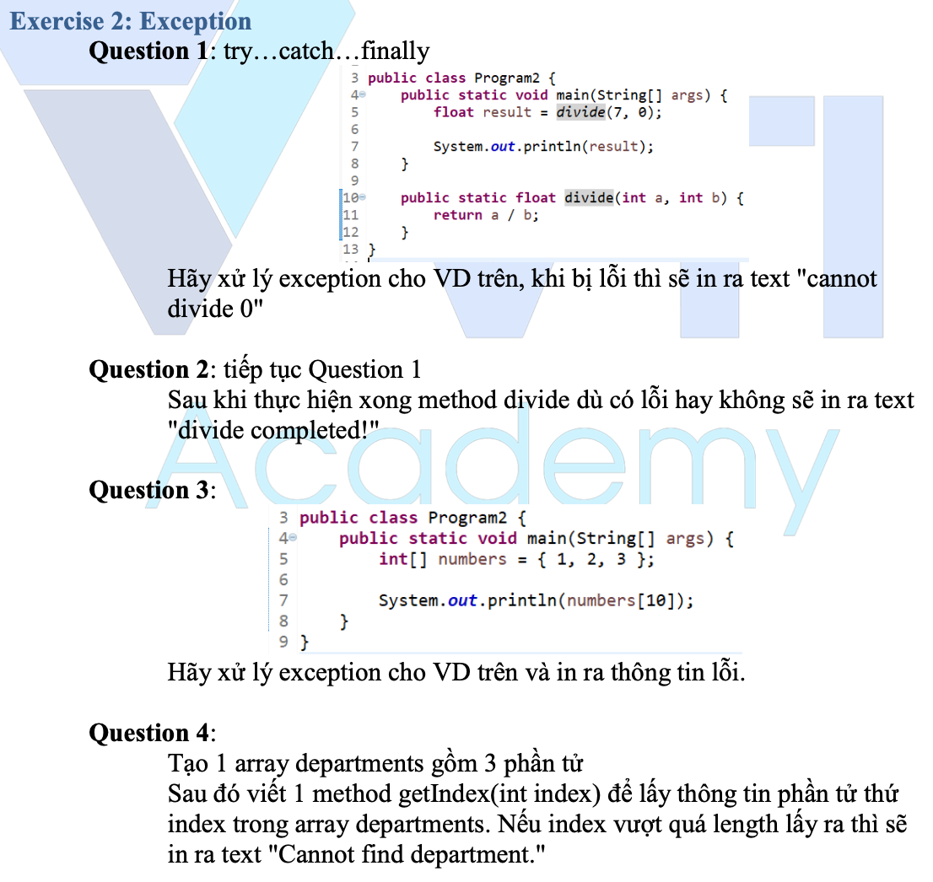
Testing System Assignments
Exercise 2: Exception

Slide 18
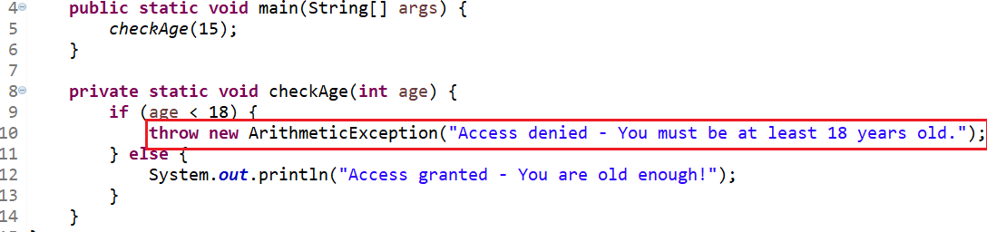
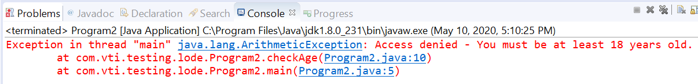
Throw & Throws

Slide 19
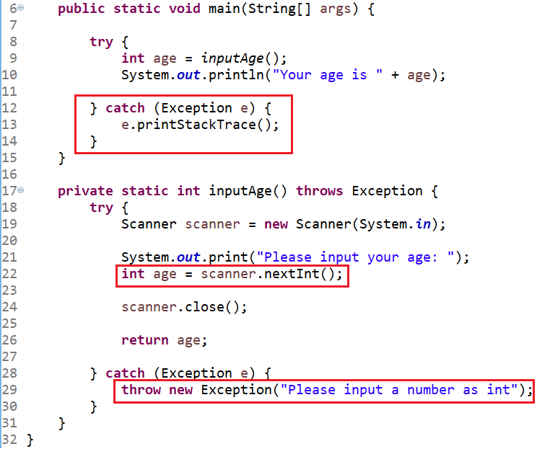
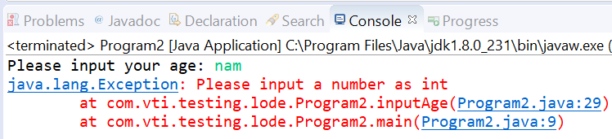
Example 1

Slide 20
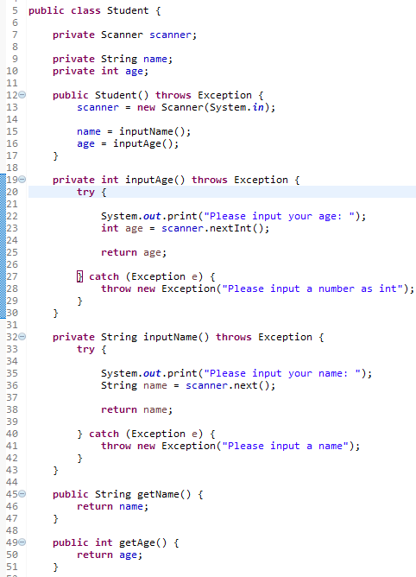
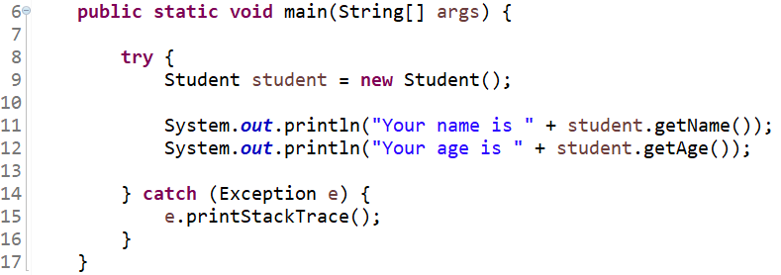
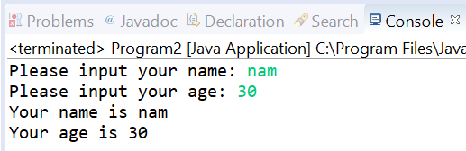
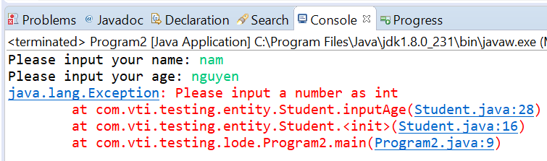
Example 2

Slide 21
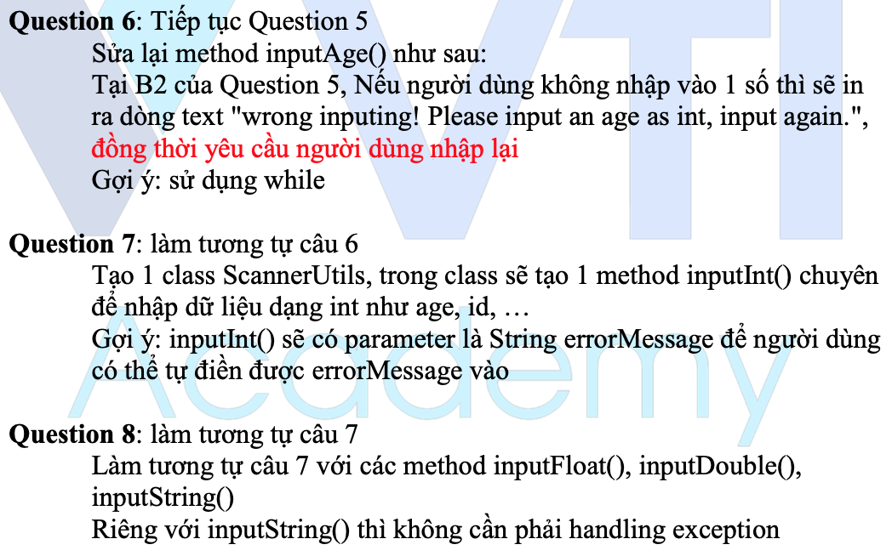
Testing System Assignments
Exercise 2: Exception

Slide 22
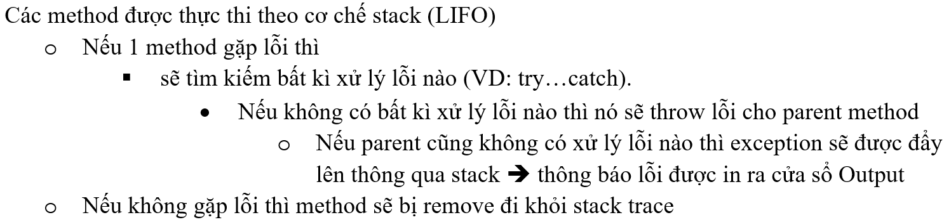
Stack Trace

Slide 23
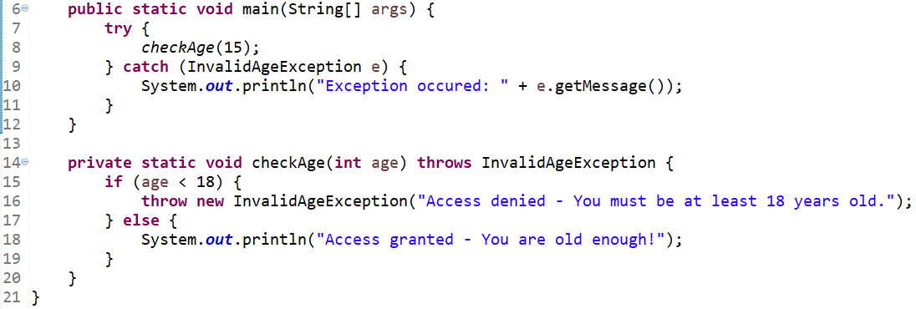
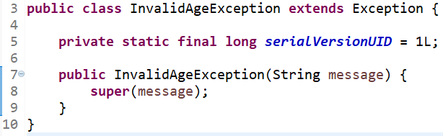
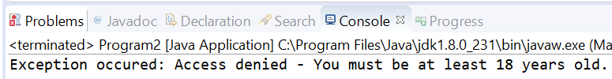
Custom Exception

Slide 24
Testing System Assignments
Exercise 2: Exception

Slide 25
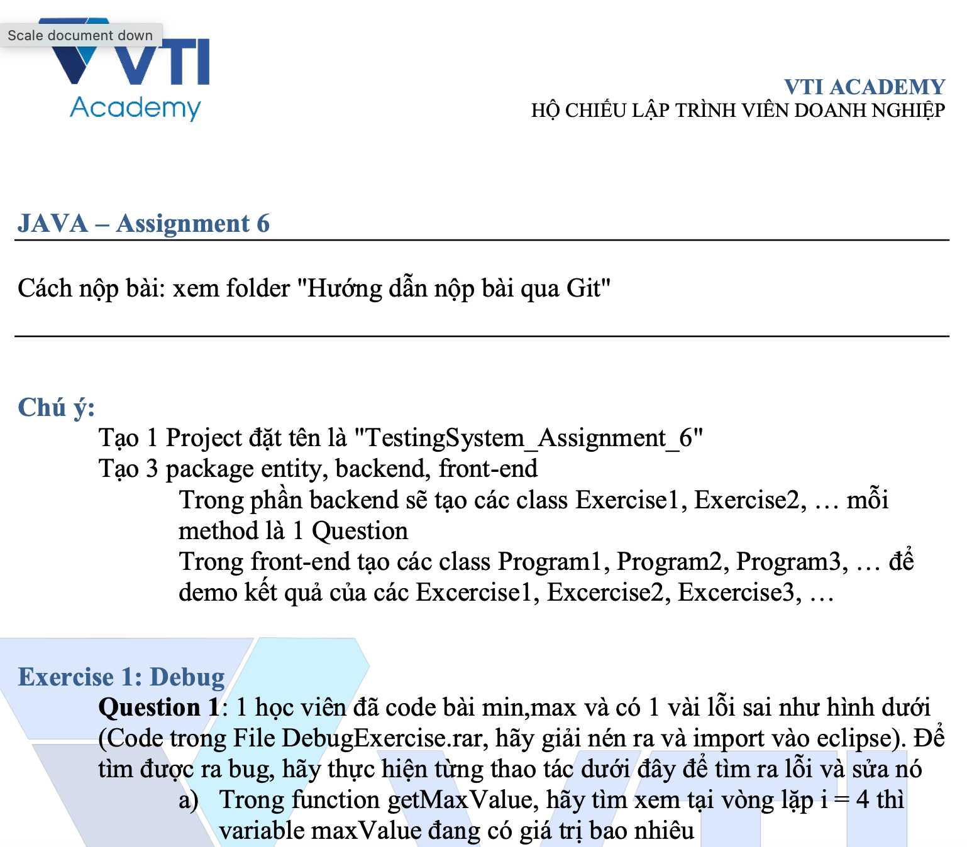
Testing System Assignments

Slide 26
Q & A
Copyright © VTI Academy All Rights Reserved

